Slide 1
GestureSpeech
Christian Roncal
Jizhen Wang
Andrew DeBiase
Shane Miller

Slide 2
What is GuestureSpeech?
GestureSpeech enables users to convert gestures to speech through the use of sign language or any other user-set gesture.
GestureSpeech makes use of machine learning to learn each gesture, the Openpose API for keypoint estimation, and Google API to convert the text generated by the neural net to speech.

Slide 3
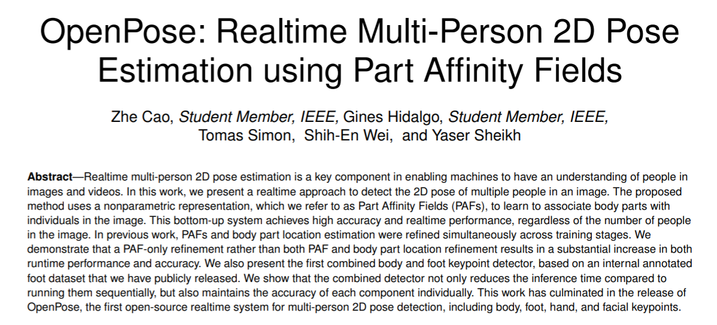
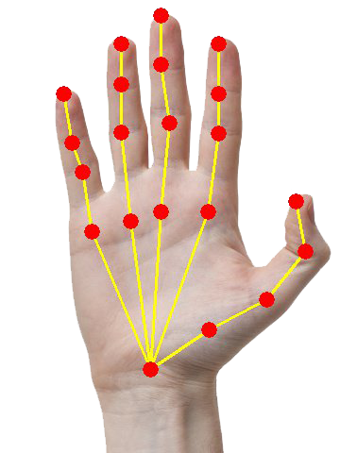

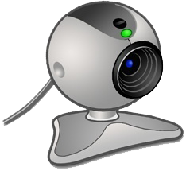
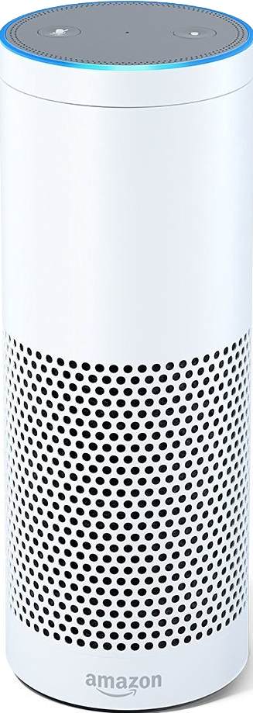
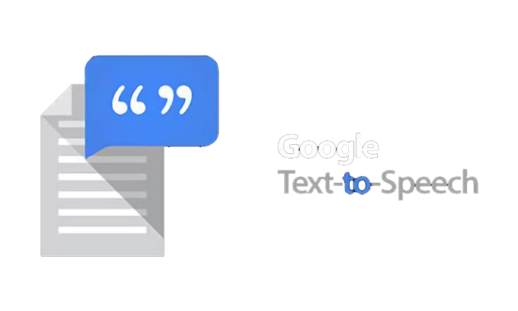
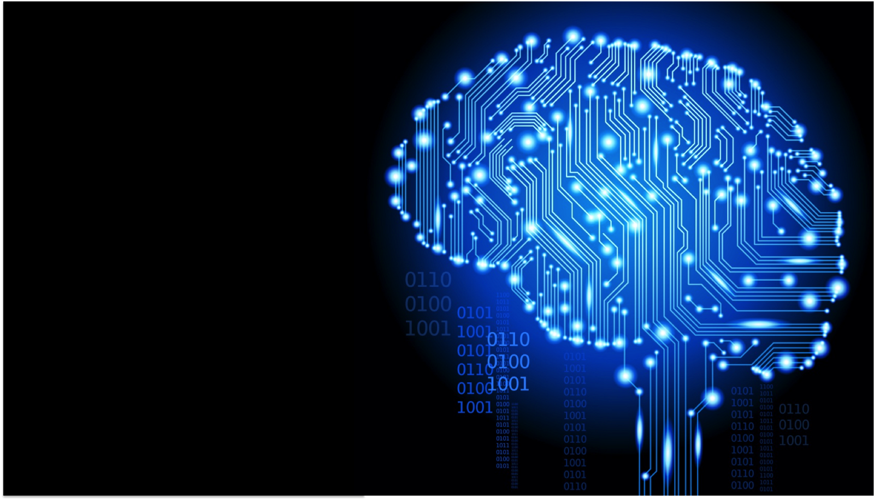

Slide 4
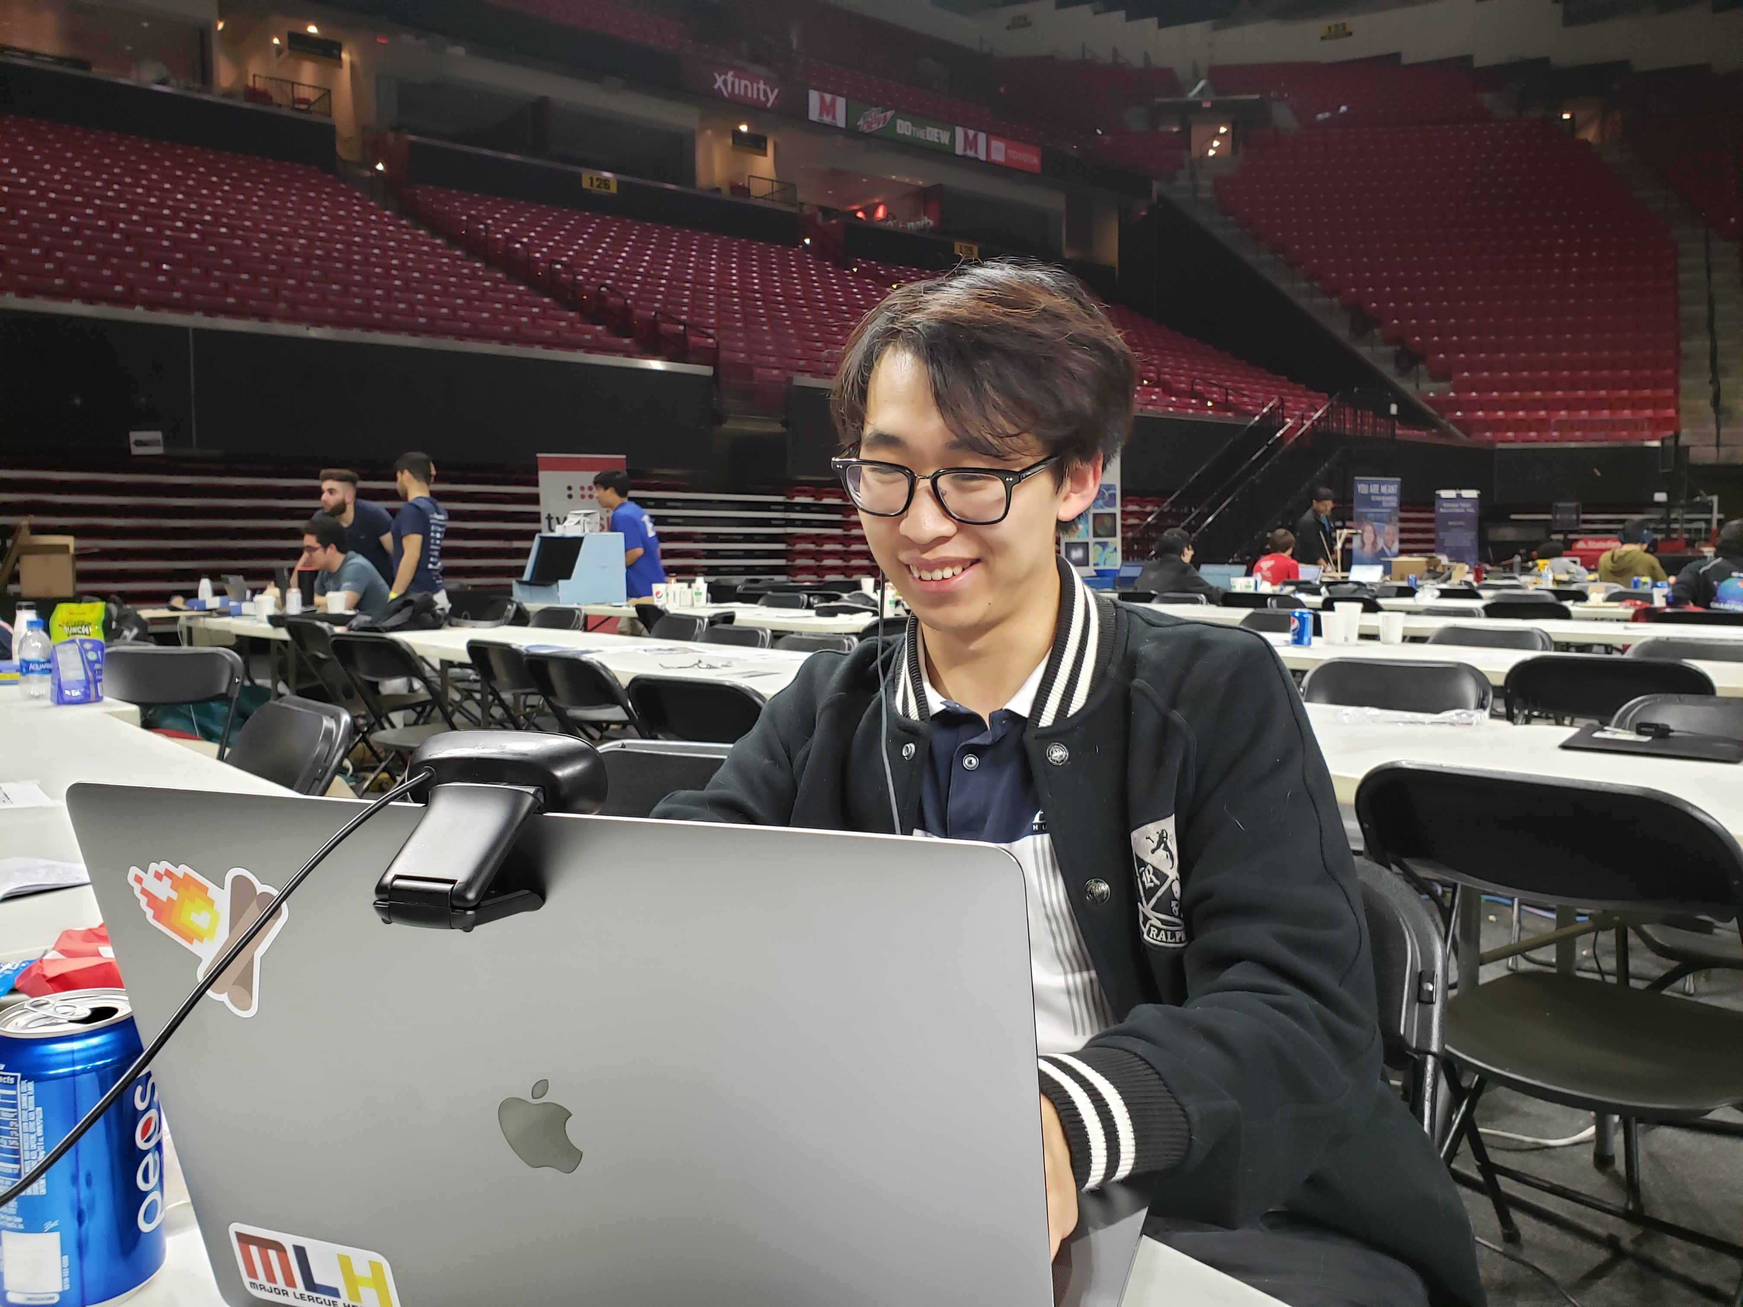
A User Will Use a Webcam in Order to Capture a Series of Images for Openpose to Analyze

Slide 5
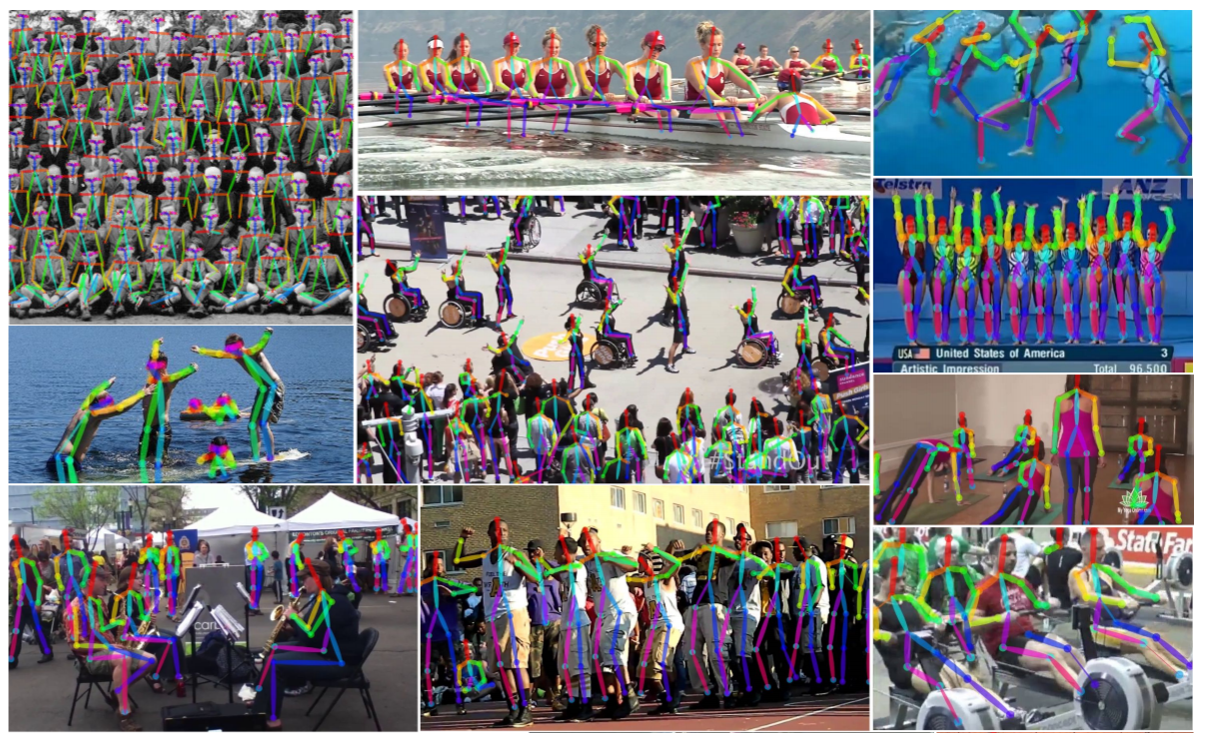
Openpose Skeletonizes People in the Images into Keypoints

Slide 6
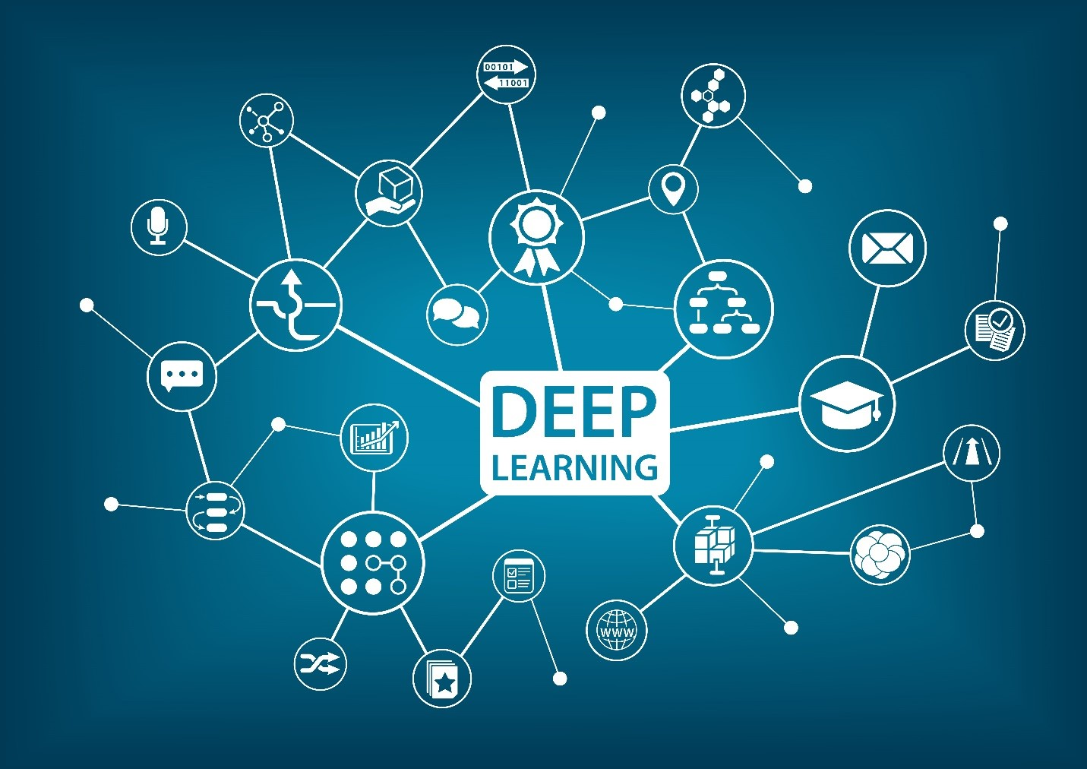
Those Keypoints Are Fed into Our Deep-learning Model to Determine What Gesture You Are Doing

Slide 7
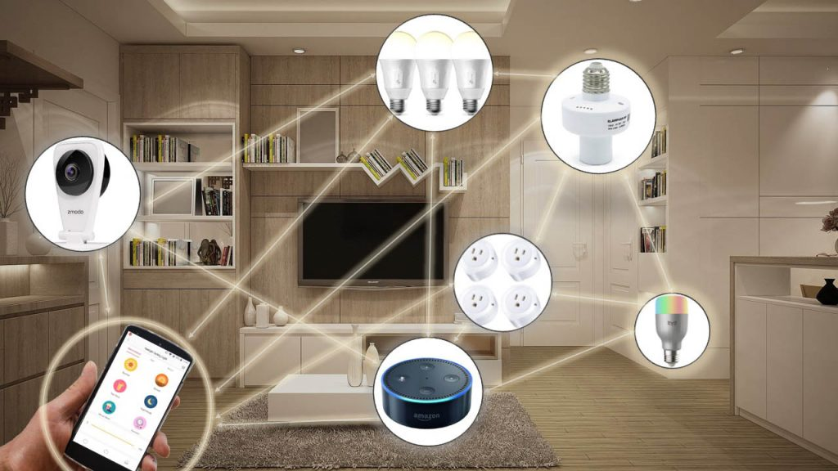
Once Our Deep-learning Model Determines What You Are Doing, The Action Can Be Preformed

Slide 8
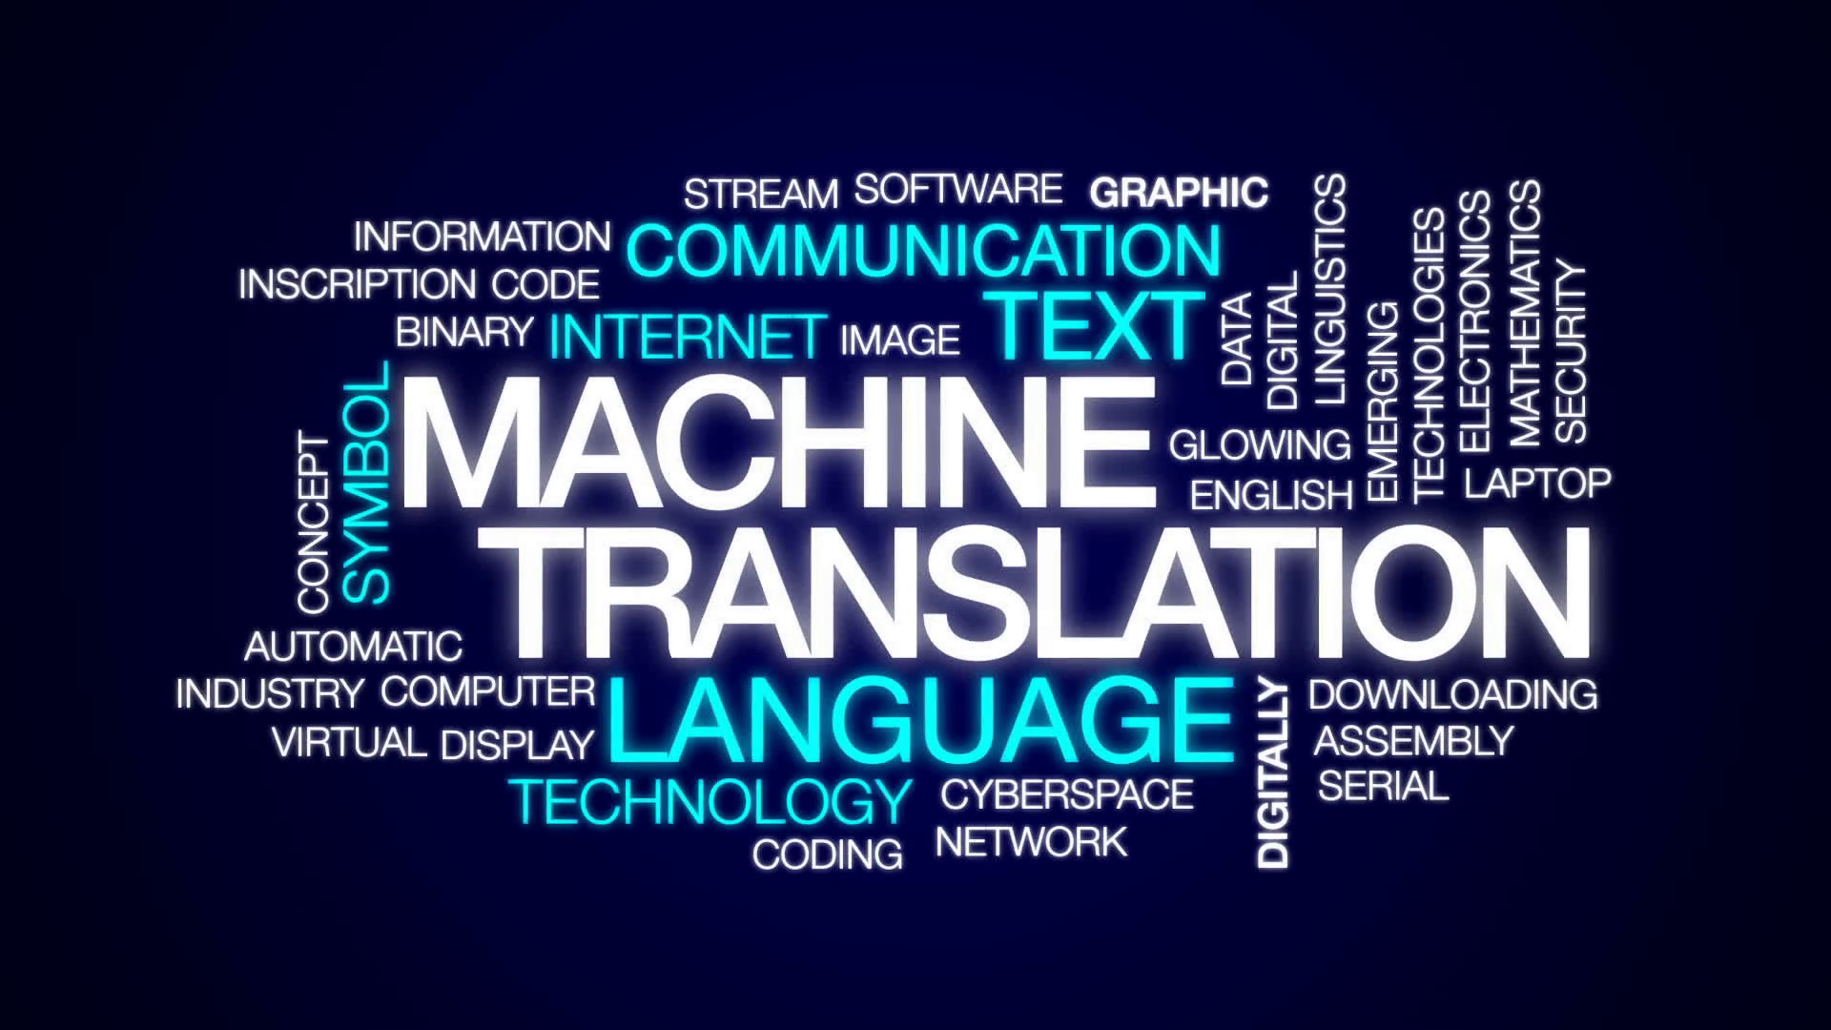
Generalized Solution For Gesture Capture
Can be used to do real-time ASL translation or captioning.
Allows for communication between two parties that may not have been able to understand each other otherwise.
Allows for gesture-based UI’s.
Smart home devices such as the the Hue lights paired with the Amazon Echo can be controlled with user-set gestures.

